Slide 1

A Google Chrome Extension
Vincent Bistricky, Kyle Butler, Dylan Brown, Christopher Begley, Adam Abdulhalim

Slide 2


What is Tab Ultra? And why?
Whether it be in a work environment, personal research, or every-day life, many users find themselves having potentially tens of tabs open all at the same time.
If your browser looks like this, you need us.
Tab Ultra is a Google Chrome-based browser extension that allows users to save, group, and manage tabs so that they can be quickly re-opened for convenience.

Slide 3
Functional and Nonfunctional Requirements
Functional
Interactable in-tab popup window
Registering opening and closing of tabs
Saving tabs to a group
Reopen tabs from group
Nonfunctional
Ease of use
Unintrusive
Rapid updating

Slide 4
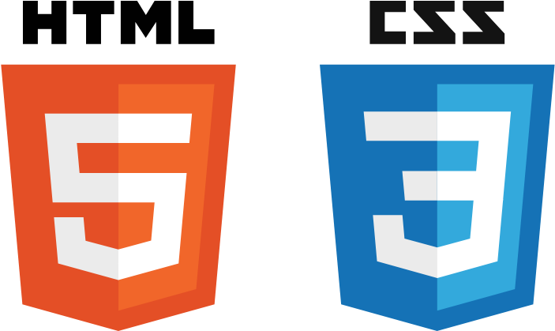


Methodology, Design, and Implementation
Heavy use of JavaScript and HTML for back-end implementation and relies on CSS for styling all front-end GUI elements.
Chrome API used for the functionality of saving tabs between browsing sessions.
Emphasis on keeping tabs in groups and being able to modify and open them easily.

Slide 5
Demonstration

Slide 6
Contributions
Vincent Bistricky – Team lead and Director
Kyle Butler – Frontend HTML and CSS implementation
Adam Abdulhalim – Backend HTML and storage functionality
Christopher Begley – Backend HTML and popup implementation
Dylan Brown – UI/Web design and branding

